Slide 1
“Infinity Finance Bank”
Bank Loan management System website
15413 : Prajakta Joshi
15414 : Shreya Joshi

Slide 2
Introduction
Our website (Infinity Finance Bank) mainly focuses on providing the information to the customer regarding the loans ,its types, eligibility and about the respected documents.
We provide financial support to common people to fulfil their dreams through our loans.
This website also provides a user-friendly and accurate calculator which informs the customer regarding EMI and tenure .

Slide 3
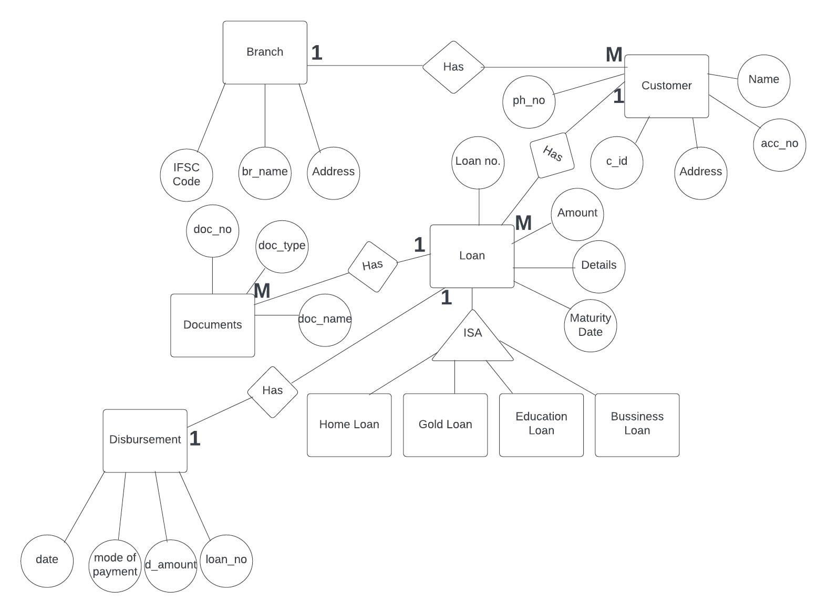
➢ System Design
ERD: Entity Relationship Diagram

Slide 4
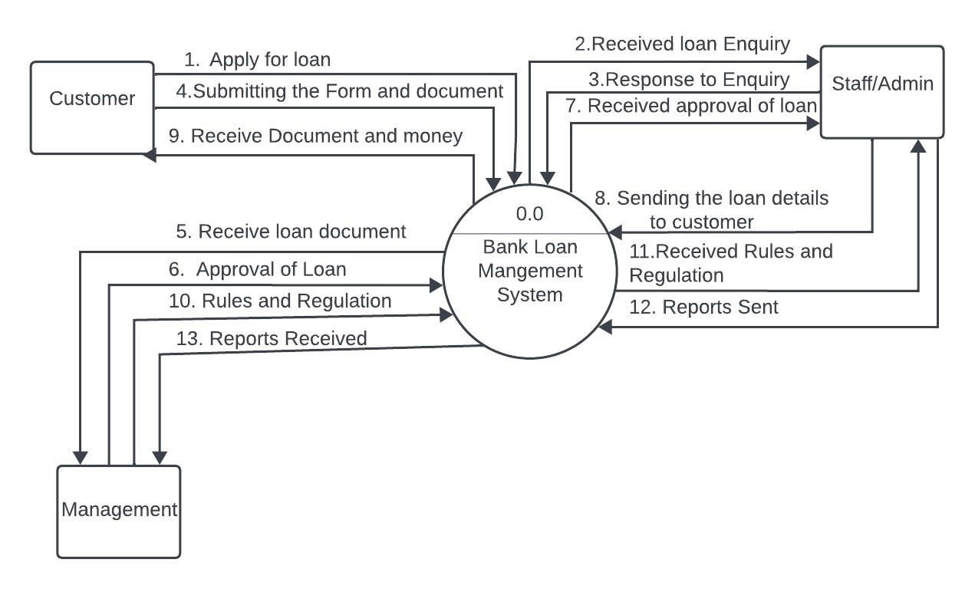
DFD-Data Flow Diagram
●

Slide 5
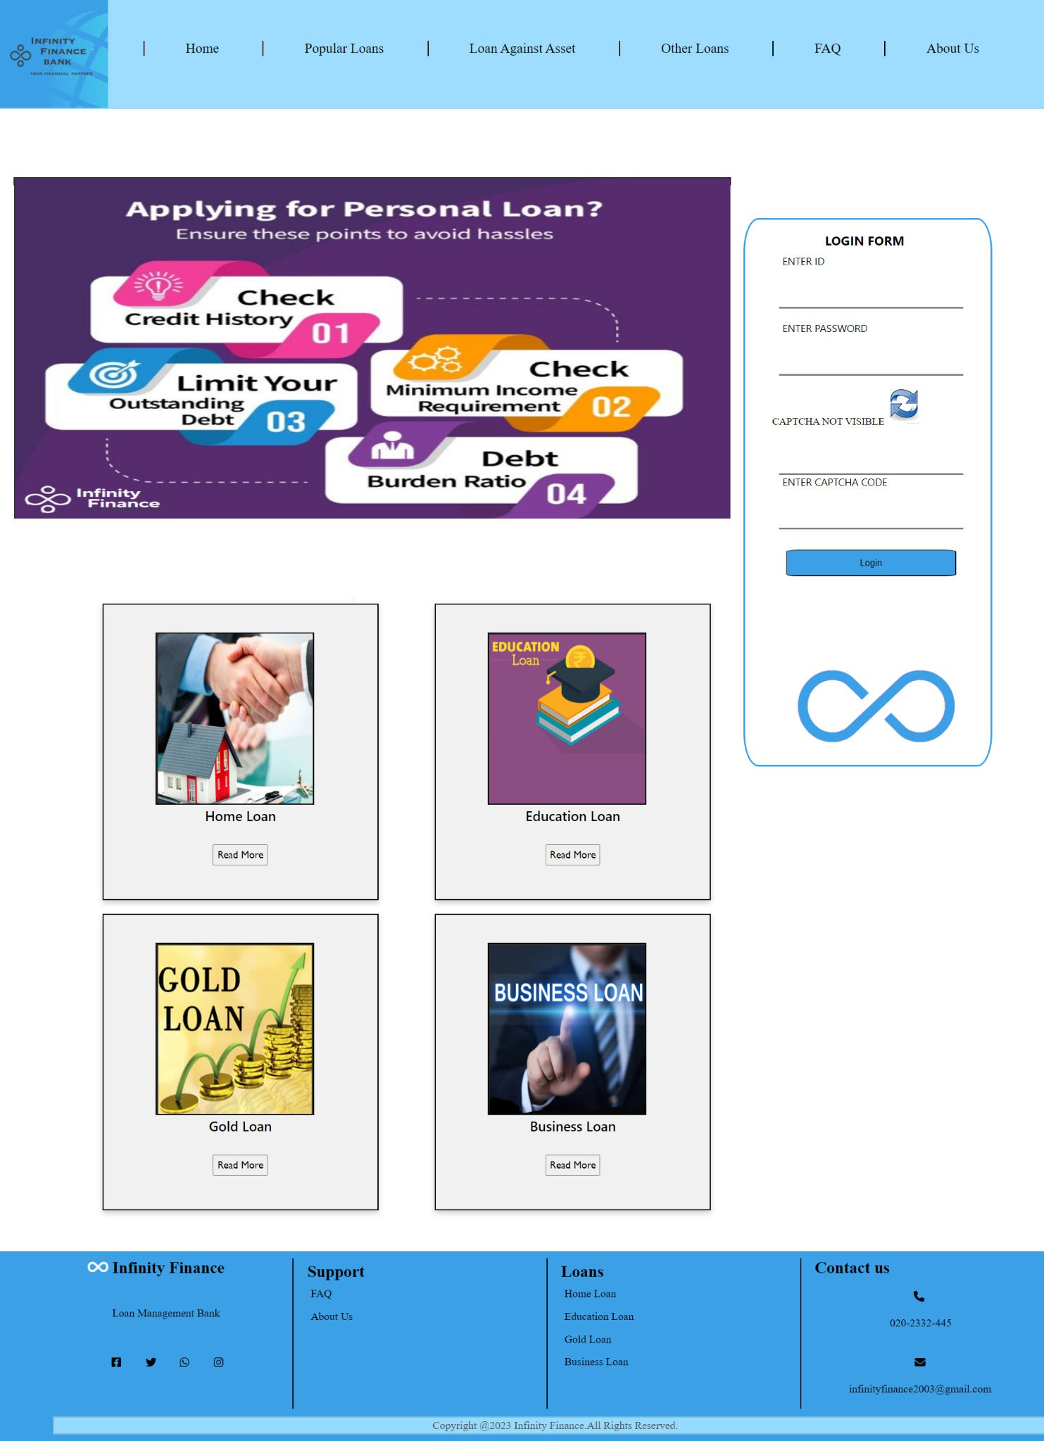
Layout of the Website(Snapshots) Homepage
•

Slide 6
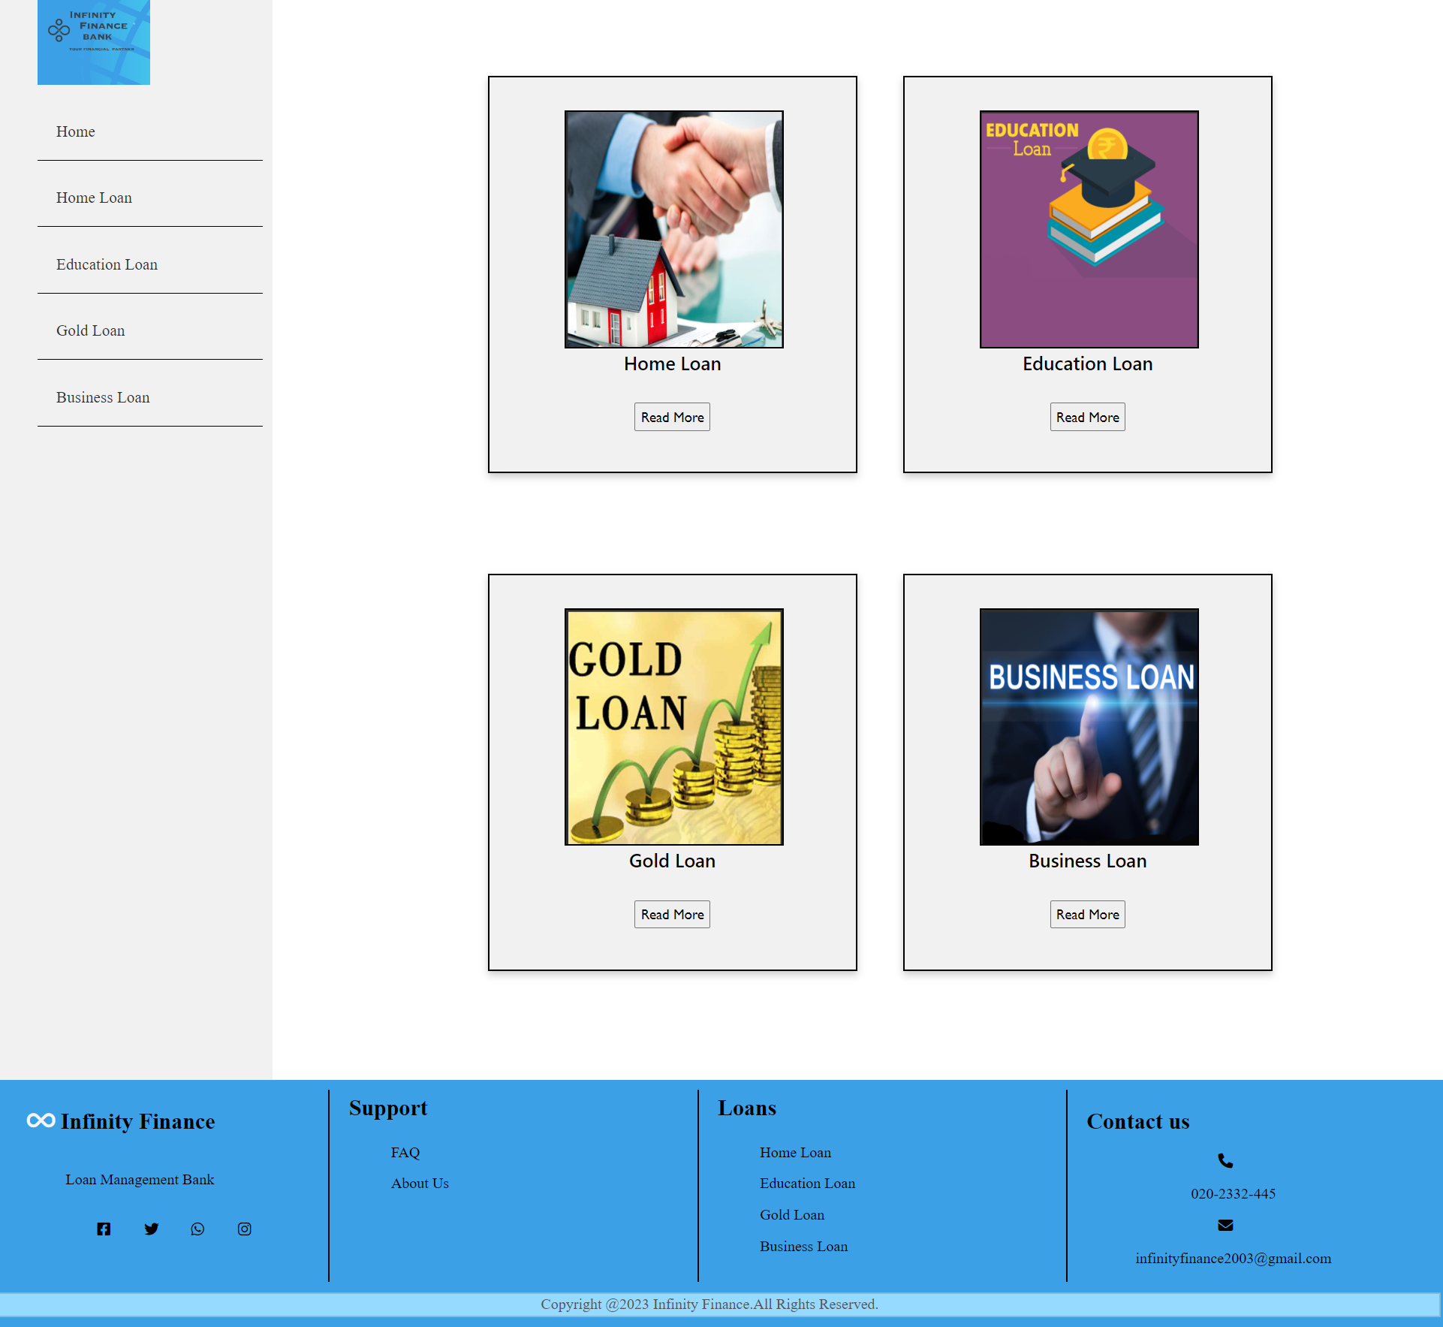
After customer filled the form of login following page will be appeared.

Slide 7
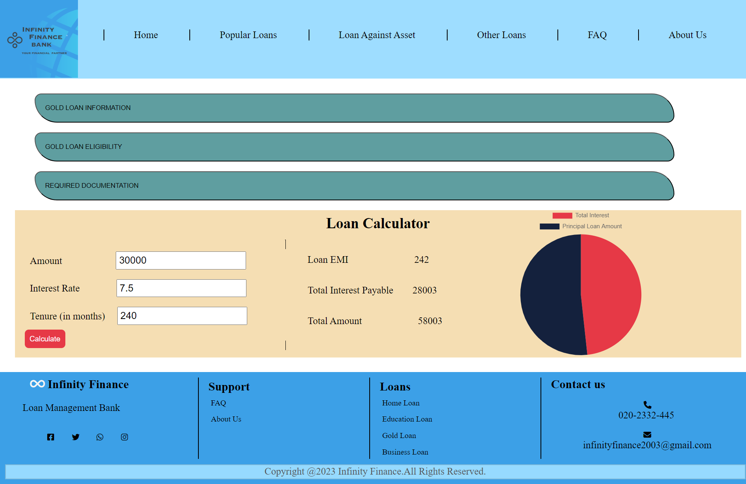
Gold Loan Information

Slide 8
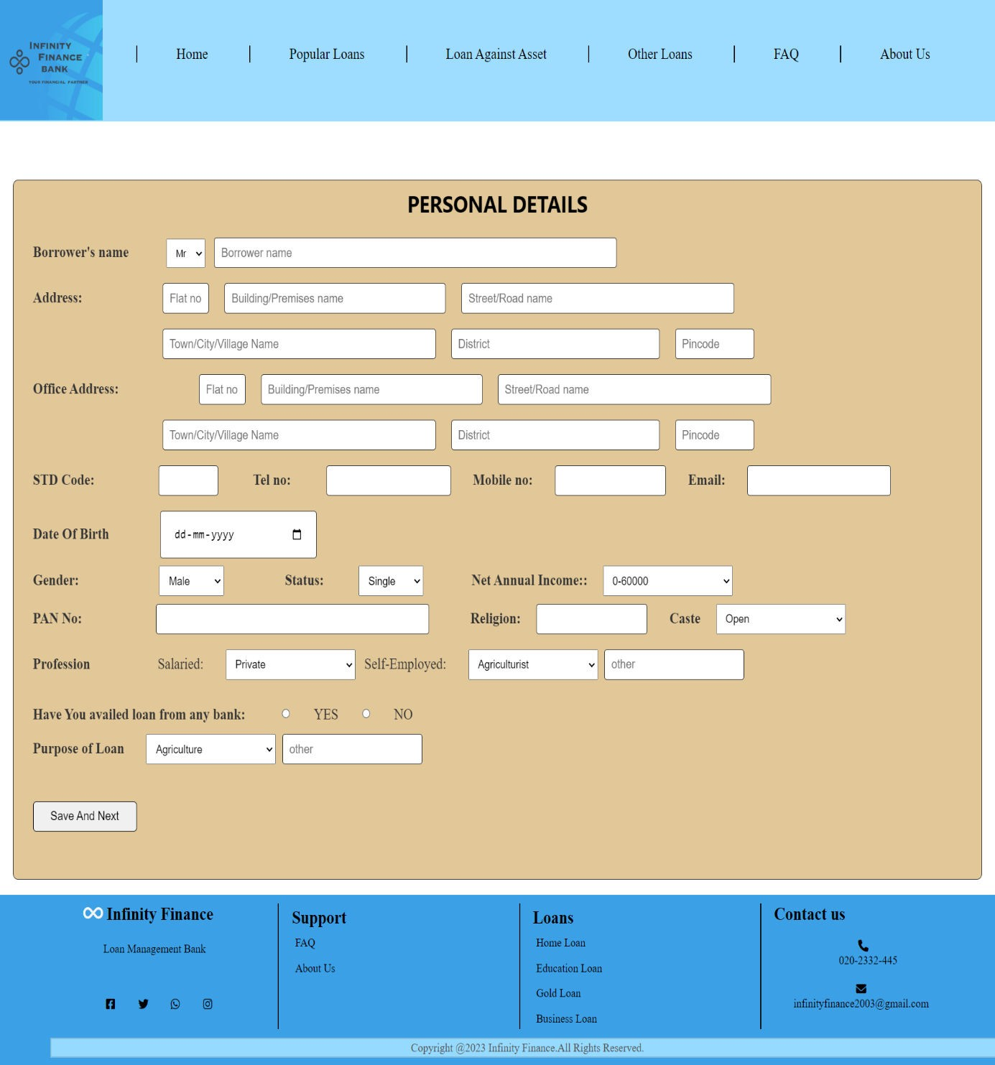
Gold Loan Form

Slide 9
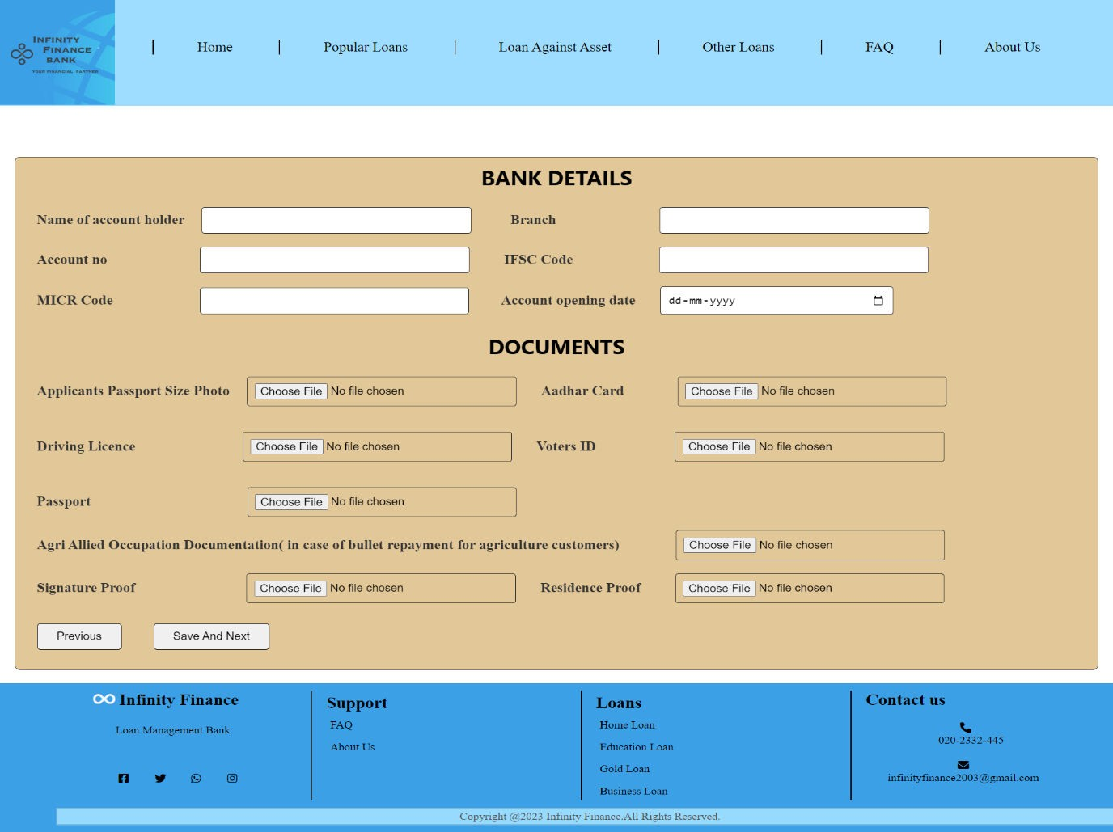


Slide 10
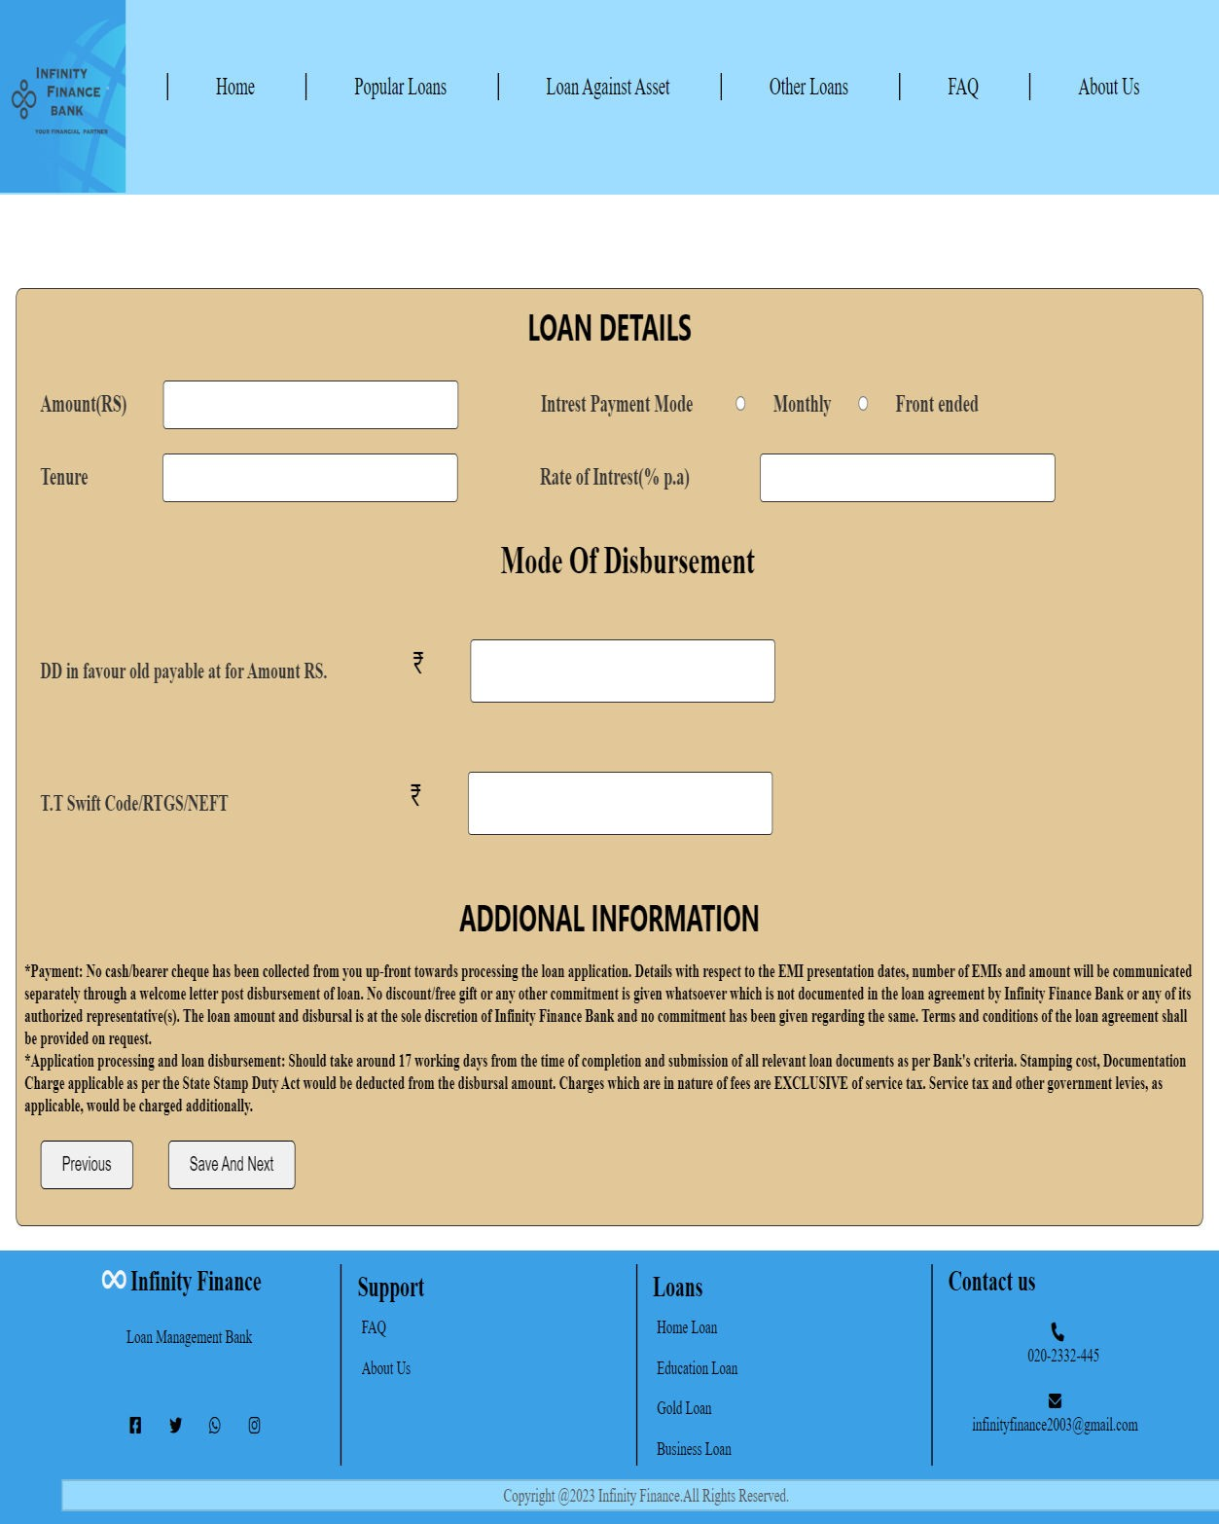


Slide 11
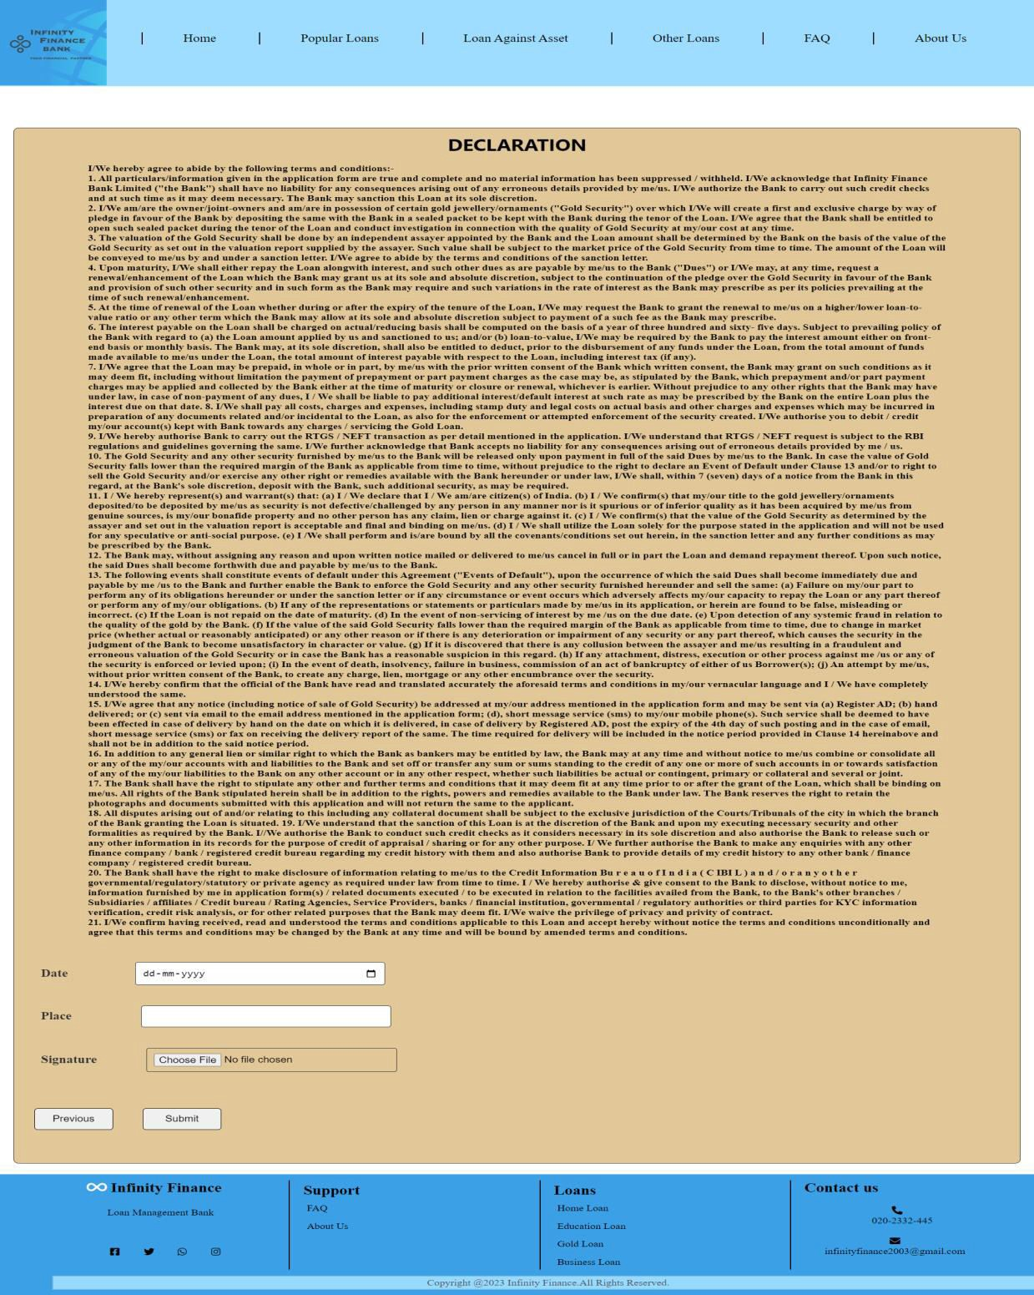

Slide 12
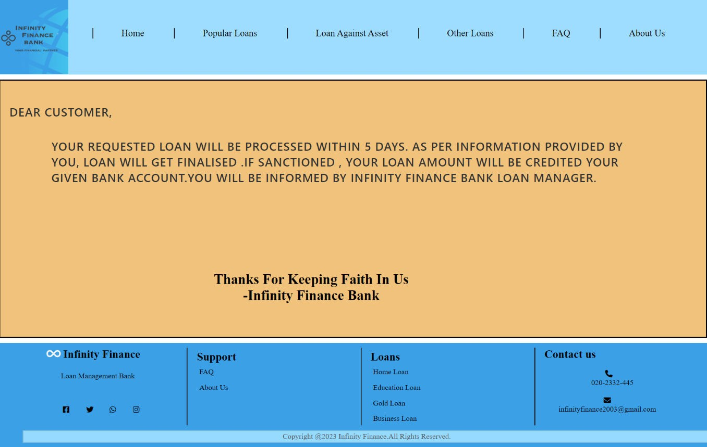
After Submitting the loan form, this page will be displayed
Likewise this website consists of 3 more other types of loan, their information , calculator and form .

Slide 13
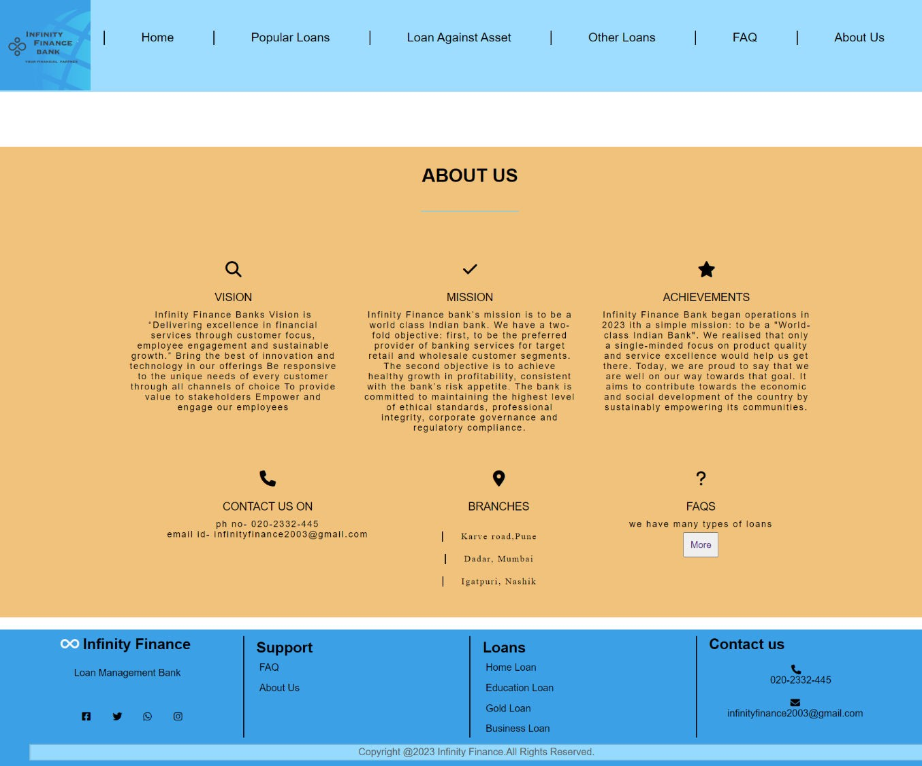
About US

Slide 14
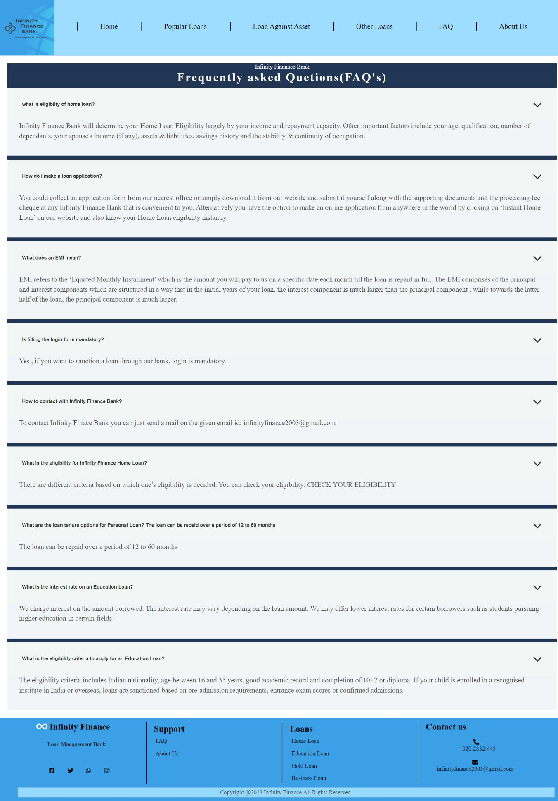
FAQ

Slide 15
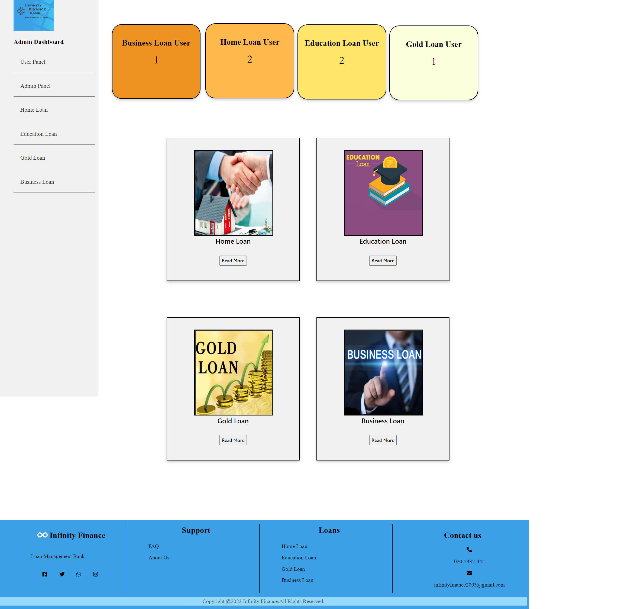
Admin Panel
If admin clicks on any type of loan , respective database table of loan will be displayed on the screen.

Slide 16
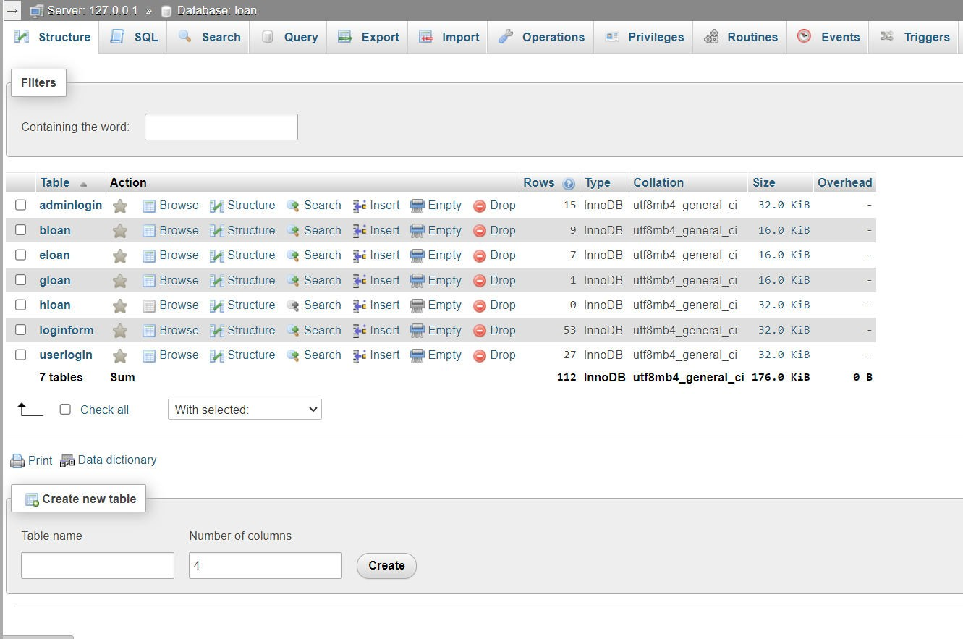
Database Layout
PHP Database

Slide 17
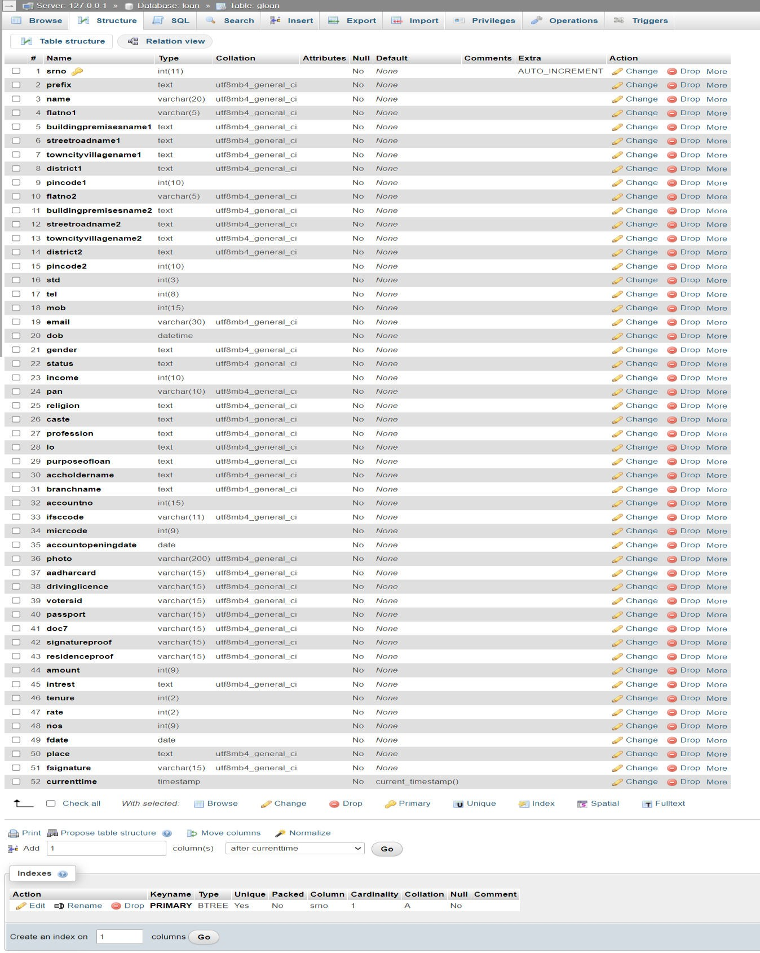
Gold Loan Table Structure

Slide 18
Thank you !! ☺

